Slide 1
PROJECT TITLE
CAPSTONE PROJECT
Presented By: Yogen Avinash Aralaguppi
Student Name : Yogen Avinash Aralaguppi
College Name & Department : Amrita Vishwa Vidyapeetham

Slide 2
OUTLINE
Problem Statement
Technology used
Wow factor
End users
Result
Conclusion
Git-hub Link
Future scope

Slide 3
Problem Statement
Secure communication is an emerging issue because of rising cyber attacks. Conventional encryption can be identified and is therefore susceptible to hackers. This project aims to conceal messages in images by employing Least Significant Bit (LSB) encoding coupled with XOR encryption, thus remaining secret but imperceptible to the human eye.

Slide 4
Technology used
Programming Language: Python
Libraries: PIL (Pillow), Tkinter, OS, NumPy
Security Mechanism: XOR Encryption
Steganography Method: Least Significant Bit (LSB) Encoding
,

Slide 5
Wow factors
Double-Layer Security: Combines steganography (LSB) with encryption (XOR) to ensure high confidentiality.
User-Friendly Interface: Simple GUI for encoding and decoding messages.
Undetectable: Hidden data does not distort the image significantly, avoiding suspicion.

Slide 6
End users
Cybersecurity professionals
Privacy-conscious users
Law enforcement & government agencies
Researchers & academicians

Slide 7
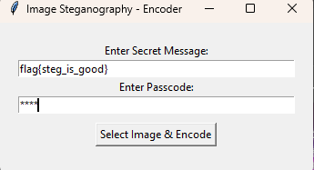
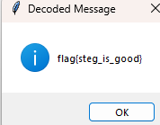
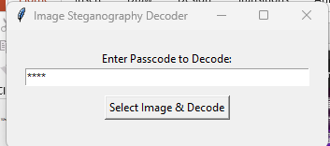
Results
Successfully hides messages within an image without noticeable changes.
Messages can be extracted only with the correct password, adding an extra layer of security.
Prevents detection through basic visual or statistical analysis.

Slide 8
Conclusion
This project demonstrates effective hidden communication using image steganography and encryption. By combining LSB encoding with XOR encryption, it provides a secure method for message hiding that can be used in various cybersecurity and privacy-focused applications.

Slide 9
GitHub Link
https://github.com/yogen-py/Steg.git

Slide 10
Future scope(optional)
AI-Based Detection Resistance: Implement countermeasures against steganalysis using deep learning.
Support for Multiple File Formats: Expand beyond images to audio/video steganography.
Mobile & Web Application: Make this available as a secure steganography tool for users.

Slide 11
THANK YOU

